Slide 1

Virtual Memory
Virtual memory – separation of user logical memory from physical memory
This separation allows an extremely large virtual memory to be provided for programmers when only a smaller physical memory is available.
Only part of the program needs to be in memory for execution
Logical address space can therefore be much larger than physical address space
Allows address spaces to be shared by several processes
Allows for more efficient process creation
More programs running concurrently
Less I/O needed to load or swap processes

Slide 2
Virtual Memory
Virtual address space – logical view of how process is stored in memory
Usually start at address 0, contiguous addresses until end of space
Meanwhile, physical memory organized in page frames
MMU must map logical to physical
Virtual memory can be implemented via:
Demand paging
Demand segmentation

Slide 3
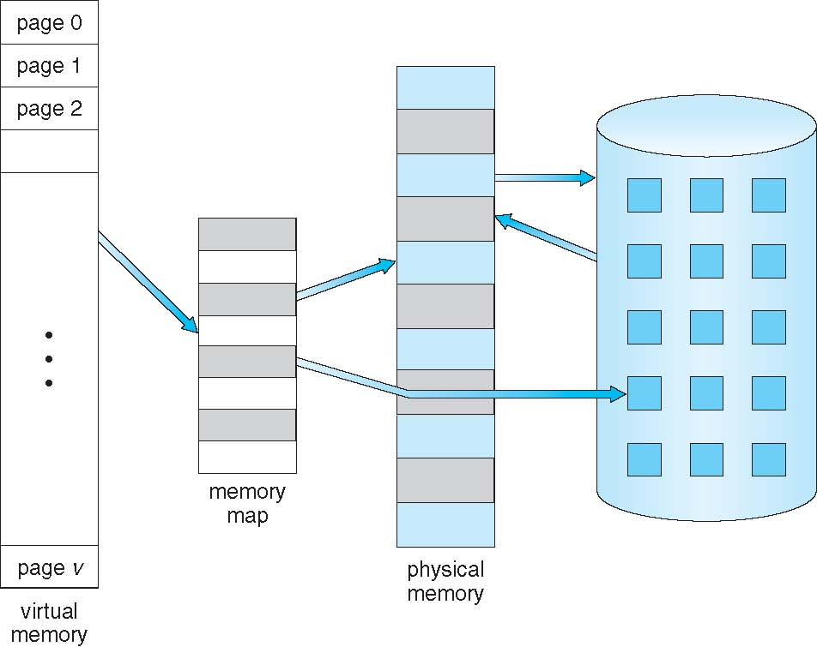
Virtual Memory

Slide 4
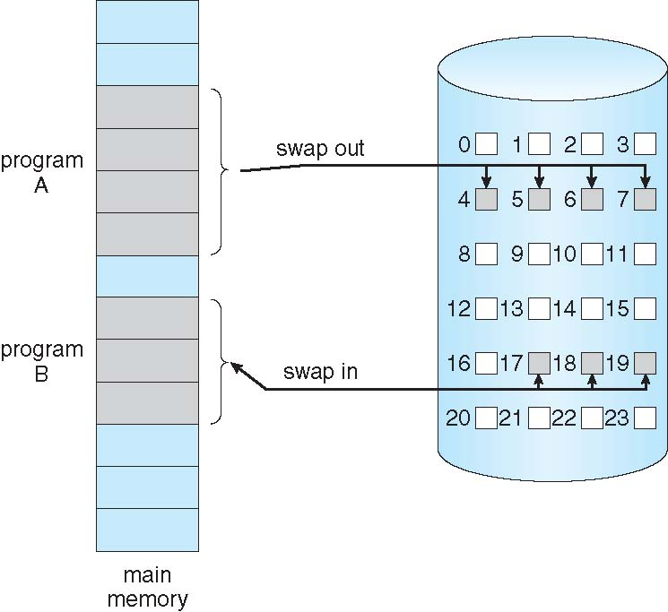
Demand Paging
Could bring entire process into memory at load time
Or bring a page into memory only when it is needed
Less I/O needed, no unnecessary I/O
Less memory needed
Faster response
More users
Similar to paging system with swapping (diagram on right)
Page is needed ⇒ reference to it
invalid reference ⇒ abort
not-in-memory ⇒ bring to memory
Lazy swapper – never swaps a page into memory unless page will be needed
Swapper that deals with pages is a pager

Slide 5
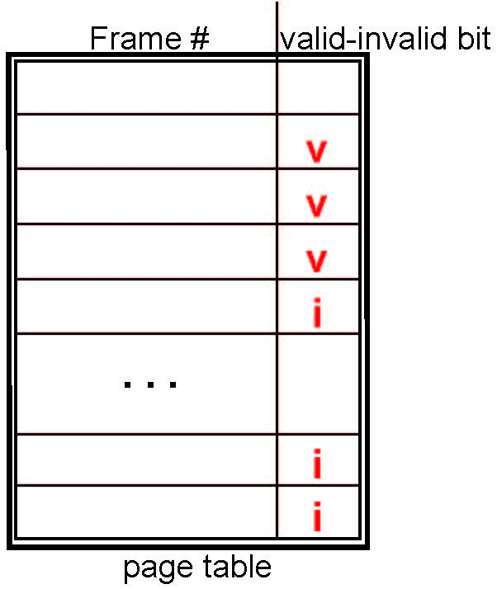
Demand Paging
With each page table entry a valid–invalid bit is associated (v - in-memory – memory resident, i - not-in-memory)
Initially valid–invalid bit is set to i on all entries
During MMU address translation, if valid–invalid bit in page table
entry is i - page fault

Slide 6
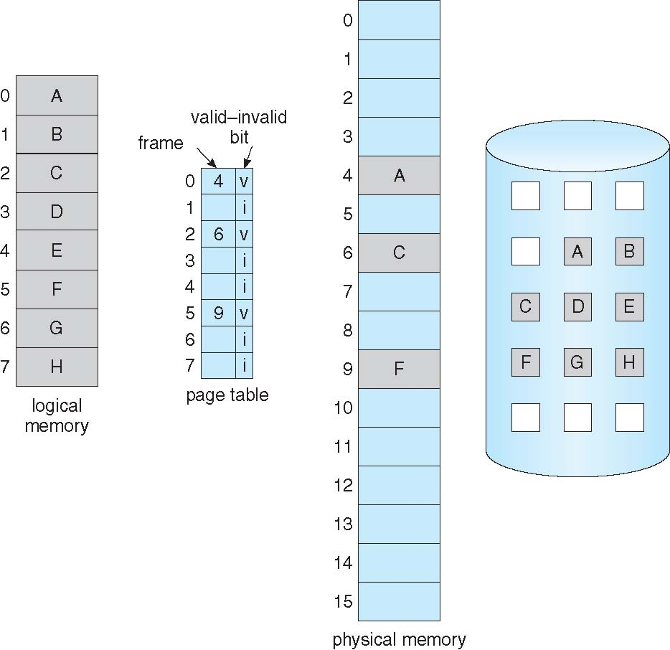
Demand Paging

Slide 7
Demand Paging
If there is a reference to a page, first reference to that page will trap to operating system:
page fault
Operating system looks at another table to decide:
Invalid reference ⇒ abort
Just not in memory
Find free frame
Swap page into frame via scheduled disk operation
Reset tables to indicate page now in memory
Set validation bit = v
5.Restart the instruction that caused the page fault

Slide 8
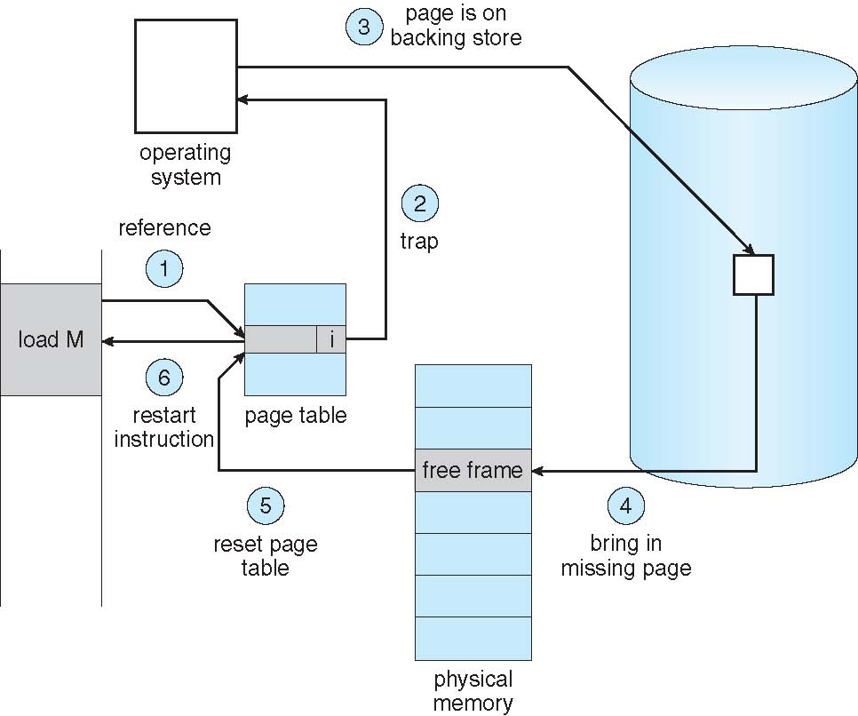
Page Fault

Slide 9
THANK YOU

